Slide 1
Outline
Three steps for finding similar items
Shingling: documents -> sets
Min-hashing: sets -> signatures
Locality-sensitive-hashing: signatures -> similarity
Locality-Sensitive-Hashing (LSH)
Characteristics of LSH
Two Applications
Finding similar fingerprints
Finding similar news articles

Slide 2
Locality Sensitive Hashing
Candidate
pairs:
those pairs
of signatures
that we need
to test for
similarity
Shingling
Min-Hash-
ing
Locality-
Sensitive
Hashing
Docu-
ment
The set
of strings
of length k
that appear
in the doc-
ument
Signatures:
short integer
vectors that
represent the
sets, and
reflect their
similarity
Step 3: Locality-Sensitive Hashing: Focus on pairs of signatures likely to be from similar documents

Slide 3
Motivation for Locality Sensitive Hashing
Used k-shingles to create sets that summarize documents
Used Minhashing to generate signatures that represent sets of shingles, reflect their similarity
Suppose we need to find near-duplicate documents among a million 10⁶ documents
Naïvely, we would have to compute pairwise Jaccard similarities for every pair of signatures
10⁶ choose 2
Recall: for large n, is approximately n²/2
≈ 5*10¹¹ comparisons
At 10⁵ secs/day and 10⁶ comparisons/sec, it would take 6 days

Slide 4
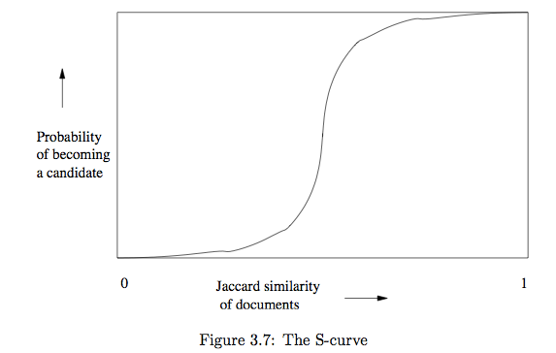
Locality Sensitive Hashing
Or Near-neighbor search
Minhashing is one example of a family of functions (the minhash functions) that can be combined (by the banding technique) to distinguish strongly between pairs at a low distance from pairs at a high distance
Steepness of the S-curve reflects how effectively we can avoid false positives and false negatives among the candidate pairs
Section 3.6: more general theory of Locality Sensitive Functions

Slide 5
Locality Sensitive Hashing Overview
Hash items several times
In a way that similar items are more likely to be hashed to the same bucket than dissimilar items
Candidate Pair: Any pair that hashes to the same bucket for any of the hashings
Check only the candidate pairs for similarity
False positives: dissimilar pairs that hash to the same bucket
False negatives: truly similar pairs do not hash to the same bucket for at least one of the hash functions

Slide 6
LSH: First Cut
2
1
4
1
1
2
1
2
2
1
2
1
Goal: Find documents with Jaccard similarity at least s for some similarity threshold s (e.g. s=0.8)
LSH – General idea: Use a function f(x,y) that tells whether x and y are a candidate pair: a pair of elements whose similarity must be evaluated
For Min-Hash matrix:
Hash columns of signature matrix M to many buckets
Each pair of documents that hashes into the same bucket is a candidate pair

Slide 7
Candidates from Min-Hash
2
1
4
1
1
2
1
2
2
1
2
1
Pick a similarity threshold s (0 < s < 1)
Columns x and y of M are a candidate pair if their signatures agree on at least fraction s of their rows: M (i, x) = M (i, y) for at least frac. s values of i
We expect documents x and y to have the same (Jaccard) similarity as their signatures

Slide 8
LSH for Min-Hash
2
1
4
1
1
2
1
2
2
1
2
1
Big idea: Hash columns of signature matrix M several times
Arrange that (only) similar columns are likely to hash to the same bucket, with high probability
Candidate pairs are those that hash to the same bucket

Slide 9
Partition M into b Bands
2
1
4
1
1
2
1
2
2
1
2
1
r rows
per band
b bands
One
signature
Signature matrix M

Slide 10
Partition Signatures M into Bands
Divide matrix M into b bands of r rows
Signatures are still too big, so we check band by band
So, check “similar signatures” becomes check “similar bands”
For each band, hash its portion of each column to a hash table with k buckets
Make k as large as possible
Use a separate bucket array for each band so columns with the same vector in different bands don’t hash to same bucket
Candidate column pairs are those that hash to the same bucket for ≥ 1 band
Tune b and r to catch most similar pairs, but few non-similar pairs

Slide 11
Buckets
Columns 2 and 6
are probably identical.
Columns 6 and 7 are
surely different.
Matrix M
r rows
b bands

Slide 12
Example of Bands
Assume the following case:
Suppose 100,000 columns of M
Correspond to signatures for 100,000 documents
Signatures of 100 integers (rows)
Correspond to 100 hash functions used in minhashing
4 bytes per integer
Therefore, signatures take 40Mb (4 x 100 x 100,000)
Choose b = 20 bands of r = 5 rows of integers/band
Goal: Find pairs of documents that are at least s = 0.8 or 80% similar

Slide 13
Recall: Minhashing Example
Input matrix
Signature matrix M
1
4
3
4
7
6
1
2
5
1
0
1
0
2
1
2
1
3
2
1
0
0
1
2
1
4
1
7
1
0
1
0
1
1
2
1
2
6
3
0
1
0
1
2
6
0
1
0
1
5
7
1
0
1
0
4
5
1
0
1
0

Slide 14
Analysis of Banding Technique
Use b bands of r rows each
Pair of documents have Jaccard similarity t
Probability that minhash signatures for the documents agree in any one particular row of the signature matrix is t
Columns C₁ and C₂ in signature matrix have similarity t
Pick any band (r rows)
Prob. that all rows in band are equal = t^{r}
Prob. that not all r rows are equal (some row in band is unequal) = 1 - t^{r}
Prob. that no band has rows that are all equal = (1 - t^{r})^{b}
Prob. that at least 1 band has rows that are all equal (which is the probability of being a candidate pair) = 1 - (1 - t^{r})^{b}

Slide 15
C₁, C₂ are 80% Similar
2
1
4
1
1
2
1
2
2
1
2
1
Find pairs of ≥ s=0.8 similarity, set b=20, r=5
Assume: sim(C₁, C₂) = 0.8
Since sim(C₁, C₂) ≥ s, we want C₁, C₂ to be a candidate pair
We want them to hash to at least 1 common bucket (at least one band is identical)
Probability C₁, C₂ identical in one particular band: t^{r} = (0.8)⁵ = 0.328
Probability C₁, C₂ are not similar in all of the 20 bands: (1 - t^{r})^{b} = (1-0.328)²⁰ = 0.00035
i.e., about .035% of the 80%-similar column pairs are false negatives (truly similar pairs that we miss)
We would find 99.965% pairs of truly similar documents

Slide 16
C₁, C₂ are 30% Similar
2
1
4
1
1
2
1
2
2
1
2
1
Find pairs of ≥ s=0.3 similarity, set b=20, r=5
Assume: sim(C₁, C₂) = 0.3
Since sim(C₁, C₂) < s we want C₁, C₂ to hash to NO common buckets (all bands should be different)
Should NOT be a candidate pair!
Probability C₁, C₂ identical in one particular band:
t^{r} = (0.3)⁵ = 0.00243
Will identify C1, C2 as candidate pair if they are identical in at least one band
Probability C₁, C₂ identical in at least 1 of 20 bands:
1 - (1 - t^{r})^{b} = 1 - (1 - 0.00243)²⁰ = 0.0474
Approximately 4.74% pairs of docs with similarity 30% end up becoming candidate pairs
They are false positives (dissimilar documents that must be examined as candidate pairs but will have similarity below threshold s)

Slide 17
Other False Positives and False Negatives
For b=20, r=5, we may compute ALL the false positives and false negatives as follows:
For false negatives: (using the procedure on slide#15 to compute "?" below):
- How many true 100%-similar pairs we may miss: 0.0% (obvious)
- How many true 90%-similar pairs we may miss: ?.?%
- How many true 80%-similar pairs we may miss: 0.035% (see slide#15)
- How many true 70%-similar pairs we may miss: ?.?%
- How many true 60%-similar pairs we may miss: ?.?%
- How many true 50%-similar pairs we may miss: ?.?%
For false positives: (using the procedure on slide#16 to compute "?" below):
- How many 40%-similar pairs we may mistakenly taken as positive: ?.?%
- How many 30%-similar pairs we may mistakenly taken: 4.74% (see slide#16)
- How many 20%-similar pairs we may mistakenly taken: ?.?%
- How many 10%-similar pairs we may mistakenly taken: ?.?%
- How many 0%-similar pairs we may mistakenly taken: 0.0% (obvious)

Slide 18
LSH Involves a Tradeoff
Pick:
The number of Min-Hashes (rows of M)
The number of bands b, and
The number of rows r per band
to balance false positives/negatives
Example: If we had only b=15 bands of r=5 rows, the number of false positives would go down, but the number of false negatives would go up

Slide 19
Example of Tradeoffs
Previous example: 20 bands of 5 rows each
Probability of false negatives when C1, C2 are 80% similar: 0.00035
Probability of false positives when C1, C2 are 30% similar: 0.0474
What if we use 15 rows of 5 bands each (smaller signature matrix)?
Probability of false negatives higher when C1, C2 are 80% similar:
(1 - t^{r})^{b} = (1 - 0.8¹⁵)⁵ = (1 - 0.035)⁵ = 0.837
Probability of false positives lower when C1, C2 are 30% similar:
1 - (1 - t^{r})^{b} = 1 - (1 - 0.3¹⁵)⁵ = 7.174⁻⁸

Slide 20
Analysis of LSH – What We Want
The ideal case
Probability = 1 if t > s
Probability
of sharing
a bucket
(becoming
a candidate
pair)
No chance
if t < s
Similarity threshold s
Jaccard Similarity t =sim(C₁, C₂) of two sets

Slide 21
What 1 Band (b=1) of 1 Row (r=1) Gives You
Compare two values in similarity matrix
1-(1-t ^{r} )^{b} = 1 – (1-t ¹)¹ = t
Probability
of sharing
a bucket
Remember:
Probability of
equal hash-values
= similarity
Similarity t =sim(C₁, C₂) of two sets

Slide 22
What b Bands of r Rows Gives You: 1 - (1 - t^{r})^{b}
Form of an S-curve, regardless of values of b and r
Threshold s is where rise of curve is steepest: approximately (1/b)^{1/r}
# bands
identical
At least
one band
identical
1 -
(
)^{b}
Probability
of sharing
a bucket
s ~ (1/b)^{1/r}
1 -
t ^{r}
Some row
of a band
unequal
All rows
of a band
are equal
Similarity t=sim(C₁, C₂) of two sets
r=5, b=20, for t=0.9: 1-(1-t^{r})^{b}=0.99999; for t=0.1: 0.0000199

Slide 23
Example: b = 20; r = 5
Similarity t of two columns
Prob. that at least 1 band is identical (so a candidate pair):
t | 1-(1-t^{r})^{b}
.2 | .006
.3 | .047
.4 | .186
.5 | .470
.6 | .802
.7 | .975
.8 | .9996
Not an ideal step function
Probability rises by more than 0.6 going from similarity t = 0.4 to t = 0.6
Slope in middle > 3.0
0.6/(0.6-0.4)=3.0

Slide 24
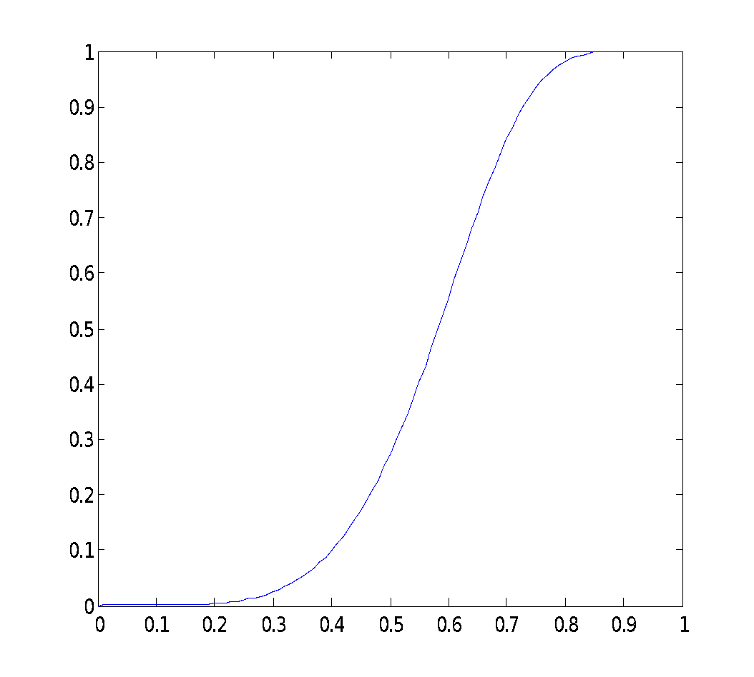
Picking r and b: The S-curve
Picking r and b to get the best S-curve
50 hash-functions (r=5, b=10)
Green area:
False Negative rate
Similar documents that are not identified as candidate pairs
Blue area:
False Positive rate
Dissimilar documents that are identified as candidate pairs
Prob. sharing a bucket
Similarity

Slide 25
Picking b and r
Threshold s defines how similar documents have to be for them to be regarded as a similar pair (e.g., s = 0.8)
Length n for minhash signatures
Pick number of bands b and number of rows r such that br = n and threshold s is approximately (1/b)^{1/r}
To avoid false negatives (green area):
Select b and r to produce a threshold lower than s
To avoid false positives (blue area):
Select b and r to produce a higher threshold than s
Prob. sharing a bucket
Similarity
b | r | (1/b)^{1/r}
50 | 2 | 0.1414
20 | 5 | 0.5493
10 | 10 | 0.7943
5 | 20 | 0.9227
Example: n=100

Slide 26
Example
(1/b)^{1/r} represents the threshold of the S curve for function
1 - (1 - t^{r})^{b}, the probability of being a candidate pair
If s=0.6 (similarity of documents to be a candidate pair) what values should you choose for b and r to reduce the number of false negatives?
To avoid false negatives: Select b and r to produce a threshold lower than s
To avoid false positives: Select b and r to produce a higher threshold than s
Could choose (b=20, r=5) or (b=50, r=2): both give threshold lower than s
Better answer probably b=20, r=5
Because b=50, r=20 will have a higher rate of false positives: TRADEOFFS
b | r | (1/b)^{1/r}
50 | 2 | 0.1414
20 | 5 | 0.5493
10 | 10 | 0.7943
5 | 20 | 0.9227
Example: n=100

Slide 27
LSH Summary
Tune M, b, r to identify almost all candidate pairs with similar signatures, but eliminate most pairs that do not have similar signatures
Then check in main memory that candidate pairs really do have similar signatures
Optional: In another 2nd pass through data, check that the remaining candidate pairs really represent similar documents

Slide 28
Summary: 3 Steps
Shingling: Convert documents to sets
We used hashing to assign each shingle an ID
Min-Hashing: Convert large sets to short signatures, while preserving similarity
We used similarity preserving hashing to generate signatures with property Pr[h_{π}(C₁) = h_{π}(C₂)] = sim(C₁, C₂)
We used hashing to get around generating random permutations
Locality-Sensitive Hashing: Focus on pairs of signatures likely to be from similar documents
We used hashing to find candidate pairs of similarity ≥ s

Slide 29
Combining the techniques (1)
Pick a value of k and construct from each document the set of k-shingles
Optionally hash the k-shingles to shorter bucket numbers
Sort the document-shingle pairs to order them by shingle
Which sets contain which elements (shingles)
Pick a length n for minhash signatures corresponding to n minhash functions and compute the minhash signatures for all the documents

Slide 30
Combining the techniques (2)
4. Choose threshold s that defines how similar documents have to be for them to be regarded as a “similar pair”
Pick number of bands b and number of rows r such that br = n
Adjust b and r to limit false positives or negatives
5. Construct candidate pairs with LSH technique
6. Examine candidate pair signatures and determine whether fraction of components where they agree is at least s
7. Optionally, if signatures are sufficiently similar, compare documents to check they are truly similar

Slide 31
CHARACTERISTICS OF LSH

Slide 32
Locality Sensitive Hashing
Or Near-neighbor search
Minhashing is one example of a family of functions (the minhash functions) that can be combined (by the banding technique) to distinguish strongly between pairs at a low distance from pairs at a high distance
Steepness of the S-curve reflects how effectively we can avoid false positives and false negatives among the candidate pairs
Section 3.6: more general theory of Locality Sensitive Functions

Slide 33
Families of Functions for LSH
Families of functions (including minhash functions) that can serve to produce candidate pairs efficiently
Space of sets and Jaccard distance OR other space and/or distance measure
Three conditions for family of functions:
More likely to make close pairs be candidate pairs than distant pairs
Statistically independent
Efficient in two ways
Be able to identify candidate pairs in time much less than time to look at all pairs
Combinable to build functions better at avoiding false positives and negatives (e.g., banding technique takes single minhash functions, combines them to produce S-curve shape we want)

Slide 34
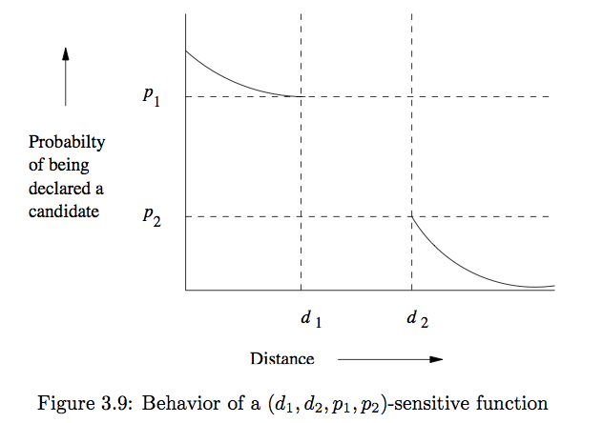
Locality-Sensitive Functions

Slide 35
LS Families of Hash Functions
Suppose we have a space S of points with a distance measure d
A family H of hash functions is said to be (d₁,d₂,p₁,p₂)-sensitive if for any x and y in S:
If d(x,y) < d₁, then prob. over all h in H, that h(x) = h(y) is at least p₁
If d(x,y) > d₂, then prob. over all h in H, that h(x) = h(y) is at most p₂
Note: we say nothing about what happens when the distance between items is between d1 and d2
But can make d1 and d2 as close as we wish
Can drive p1 and p2 apart while keeping d1 and d2 fixed

Slide 36
Locality Sensitive Hashing for Other Distance Measures
We focused on minhashing, a locality sensitive hashing family that uses Jaccard distance
Based on sets representing documents and their Jaccard similarity
Book covers LSH families for other distance measures:
Euclidean distance: based on the locations of points in a Euclidean space with some number of real-valued dimensions
Cosine distance: angle between vectors from the origin to the points in question
Edit distance: number of inserts and deletes to change one string into another
Hamming Distance: number of positions in which bit vectors differ

Slide 37
LSH and Shingling Application Examples
Matching fingerprints
Identifying similar news articles

Slide 38
LSH for Fingerprints
Typical representation is not an image, but set of locations in which minutiae are located
Place where something unusual happens: two ridges merging or a ridge ending
Place a grid over a fingerprint
Normalize for size and orientation so that identical prints will overlap
Represent fingerprint by set of grid points where minutiae are located
Possibly, treat minutiae near a grid boundary as if also present in adjacent grid points

Slide 39
Discretizing Minutiae
Minutia
located
here
Maybe pretend
it is here also
Place a minutia in several adjacent grid squares if it lies close to the border of the squares

Slide 40
Applying LSH to Fingerprints
Make a bit vector for each fingerprint’s set of grid points with minutiae
Similar to set representing a document: 1 if the shingle is in the document, 0 otherwise
We could minhash the bit vectors to obtain signatures
But since there probably aren’t too many grid points, we can work from the bit-vectors directly

Slide 41
Matching Fingerprints with LSH: Many-to-many problem
Many-to-many version of fingerprint matching: take an entire database of fingerprints and identify if there are any pairs that represent the same individual
Analogous to finding similar documents among millions of documents
Define a locality-sensitive family of hash functions:
Each function f in the family F is defined by 3 grid squares
Function f says “yes” for two fingerprints if both have minutiae in all three grid squares, otherwise, f says “no”
“Yes” means the two fingerprints are candidate pairs
Sort of “bucketization”
Each set of three points creates one bucket
Function f sends fingerprints to its bucket that have minutiae in all three grid points of f
Compare all fingerprints in each of the buckets

Slide 42
Matching Fingerprints with LSH: Many-to-One Problem
Many-to-one version : A fingerprint has been found at a crime scene, and we want to compare it with all fingerprints in a large database to see if there is a match
Could use many functions f from family F
Precompute their buckets of fingerprints to which they answer “yes” on the large database
For a new fingerprint:
Determine which buckets it belongs to
Compare it with all fingerprints found in any of those buckets

Slide 43
Example 3.22
1024 functions chosen randomly from F
Each function f says “yes” for two fingerprints if both have minutiae in all three grid squares, otherwise, f says “no”
Suppose typical fingerprints have minutiae in 20% of the grid points
Suppose fingerprints from the same finger agree in at least 80% of their points
Probability two random fingerprints each have 1 in all three points = (0.2)⁶ = .000064
2 fingerprints, 3 points each, all independent events

Slide 44
Example: Continued
Second image
of same finger
also has 1
First image
has 1 in a
point
Probability two fingerprints from the same finger each have 1’s in three given points = ((0.2)(0.8))³ = .004096
Prob. for at least one of 1024 sets of three points = 1-(1-.004096)¹⁰²⁴ = .985
But for random fingerprints:
1-(1-.000064)¹⁰²⁴ = .063
(Analogy: t^{r})
(Analogy:
1 - (1 - t^{r})^{b})
1.5% false
negatives
6.3% false
positives

Slide 45
Choosing the number of functions from F
Want to use many functions from F, but not too many
Want a good probability of matching fingerprints from the same finger while not having too many false positives
Previous example: only 1.5% chance we fail to identify a print on the gun (false negative), but have to look at 6.3% of entire database (due to false positives)
Increasing number of functions from F increases number of false positives
Only a small benefit in reducing false negatives below 1.5%
Can use constructions/combinations of functions
Several examples in the chapter

Slide 46
Finding Same/Similar News Articles
Want to organize large repository of online news articles
Group together web pages derived from same basic text
Scenario: the same article, say from the Associated Press, appears on the Web site of many newspapers, but looks quite different
Each newspaper surrounds the text of the article with:
Its own logo and text
Ads
Perhaps links to other articles
A newspaper may also “crop” the article (delete parts)

Slide 47
Variation on Shingling
Looks like earlier problem: find documents whose shingles have high Jaccard similarity
But: Shingling treats all parts of document equally
For this application, we want to ignore certain parts of the documents (e.g., ads, links to other articles, etc.)
There is a difference between text that appears in prose and text in ads or headlines/links
Prose contains greater frequency of stop_words
E.g., common words like “and” or “the”
Common to use list of several hundred most frequent words

Slide 48
New Shingling Technique
News articles have a lot of stop words, while ads do not
“Buy Sudzo” vs. “I recommend that you buy Sudzo for your laundry.”
Define a shingle to be a stop word plus the next two following words
Shingles are: “I recommend that”, “that you buy”, “you buy Sudzo”, “for your laundry”, “your laundry <nextword>”
Then compare the similarity of the sets of shingles that represent each document
Don’t use minhashing or LSH in this example

Slide 49
Why it Works
By requiring each shingle to have a stop word: bias the mapping from documents to shingles so it picked more shingles from the article than from the ads
Pages with the same article, but different ads, have higher Jaccard similarity than those with the same ads, but different articles

